Slide 1

THORN-ML: Transparent Hardware Offloaded Resilient Networking for RDMA based Distributed ML Workloads
Maziyar Nazari, Dan Noland, Giulio Sidoretti, Erika Hunhoff, Tamara Lehman, Eric Keller
11/21/2025
SoCC

Slide 2
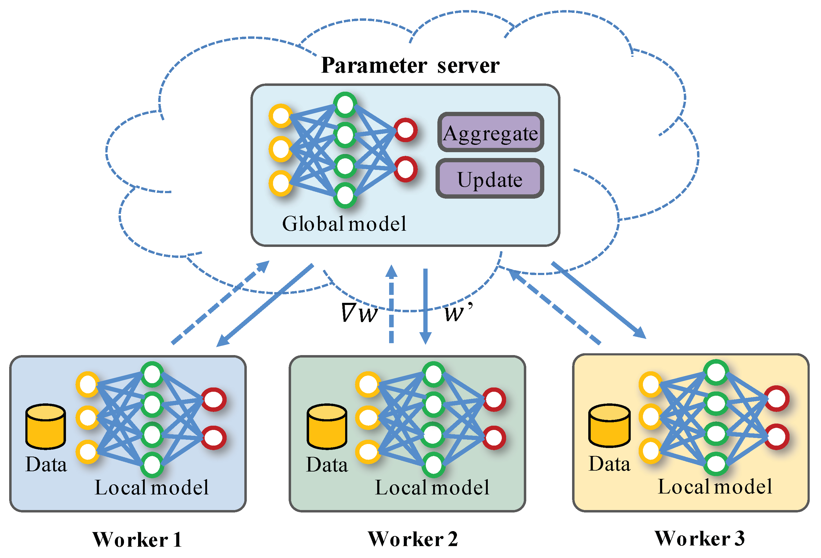
Distributed Deep Learning Training
Model sizes are rapidly increasing
Dataset sizes are exponentially growing
More and more workers are needed
Greatly increasing communication
➔ Failures are disruptive and costly

Slide 3
THORN: Transparent Hardware Offloaded Resilient Networking

Slide 4
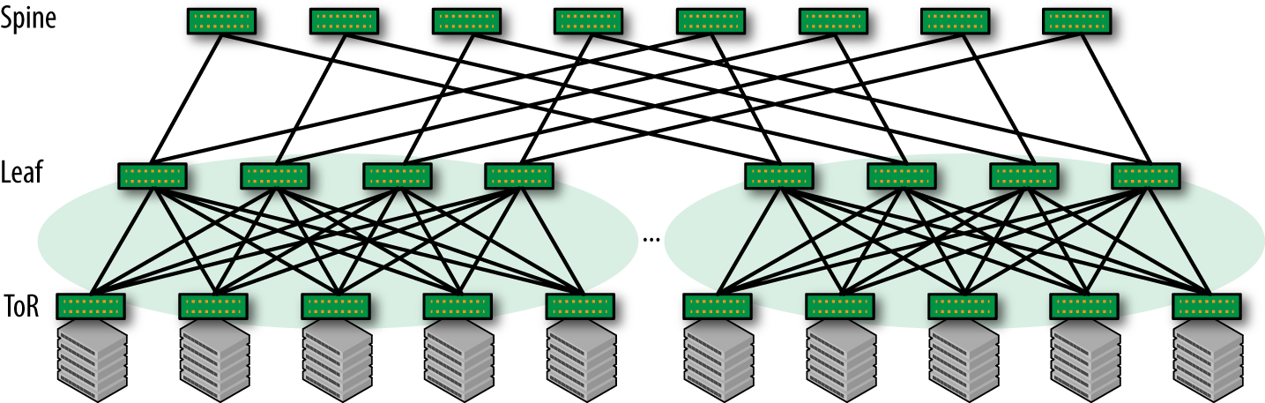
Datacenter Architecture

Slide 5


Handling Failure – Server
Frameworks take distributed check points every N iterations
(of all workers)
If host fails, all workers go back to last check point

Slide 6
Handling Failure – Network Core (leaf/spine)
Redundancy
Routing protocols
=> Minimal disruption

Slide 7
What about Datacenter Network Edge?
Network edge:
Top of Rack Switch
Network Interface Card
Cable between
Treated as host failure

Slide 8
Impact of Failure
In practice check points are taken every 10-30 minutes
(limitations in network bandwidth, storage, etc.)
The Llama 3 Herd of Models
https://arxiv.org/abs/2407.21783
16,000 GPU cluster over 54 day snapshot
(later publications suggest much larger clusters)
Network failures account for 8.4% (switches and cables), and 1.7% (NIC) of overall disruptions

Slide 9
Trending in the Wrong Direction
As cluster sizes increase
Likelihood of a single failure increases
and
Impact of a single failure increases

Slide 10
THORN: Transparent Hardware Offloaded Resilient Networking

Slide 11
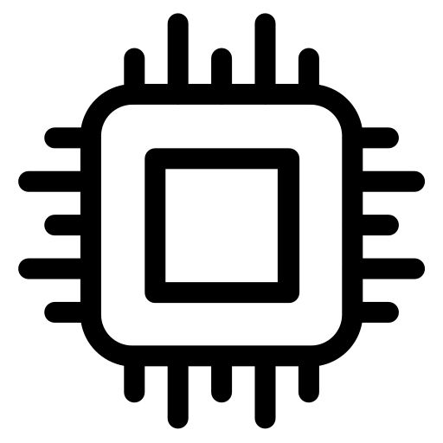





Remote Direct Memory Access (RDMA)
No CPU involvement during transfer
(packet formation, re-transmission, etc.)
==> Low latency and high throughput
Applications
Applications
Operating System
Operating System

Slide 12
THORN: Transparent Hardware Offloaded Resilient Networking

Slide 13
THORN Transparency Goals
Unmodified Application
  To work across the wide collection of frameworks
Unmodified Hardware/Protocols
  Not feasible without long standardization process
  (assuming hardware vendors agree to it)

Slide 14
RDMA Programming Model (libverbs)
Programming model tightly couples application to device
(each port on the NIC is a separate device)
Create protection domain
Register memory region
Create queue pair
post
send
Open device
Create completion queue
Poll completion

Slide 15
Application Modifications (without THORN)
Would need substantial changes to:
1) change how application interfaces with network (via RDMA),
2) introduce failure detection locally,
3) choose alternate paths in the network

Slide 16
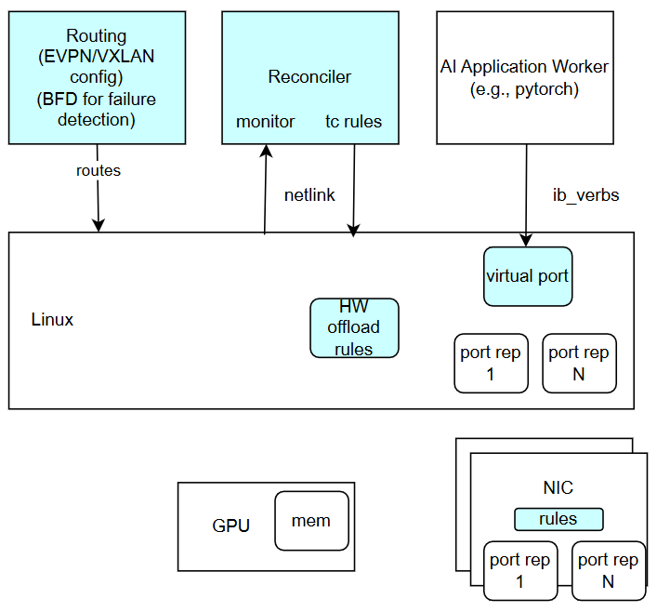
Architecture Outline
Transparent:
Introduce a single virtual port that applications bind to
Extend network fabric to host
Hardware Offload:
Leverage Linux offload capabilities
(Resilient Network is the result)

Slide 17
Virtual Port
(transparent)
Setting up SR-IOV results in:
Virtual Port that implements functions of underlying NIC
Port representors for each port that can be interacted with using the Linux network stack
Application binds to the virtual port

Slide 18
Extend Fabric
(transparent)
Routing software on host can detect failures and re-route
EVPN is BGP-based protocol used in datacenter networks to exchange MAC addresses
(no ARP) and determine paths
BFD is very low latency protocol to detect link failure

Slide 19
Offload Rules
(hardware offload)
Linux switchdev driver is able to offload rules to hardware
On NIC, there’s an e-switch capable of forwarding between devices (virtual port and port representors)
All packets generated and sent in hardware

Slide 20
Reconciler
(hardware offload)
Not all rules can be offloaded with switchdev
Translate to tc rules (which can)
But netlink is best effort
Introduce software with guaranteed correctness

Slide 21
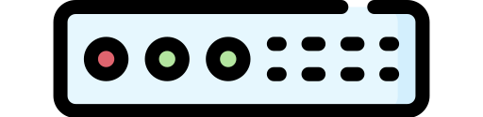
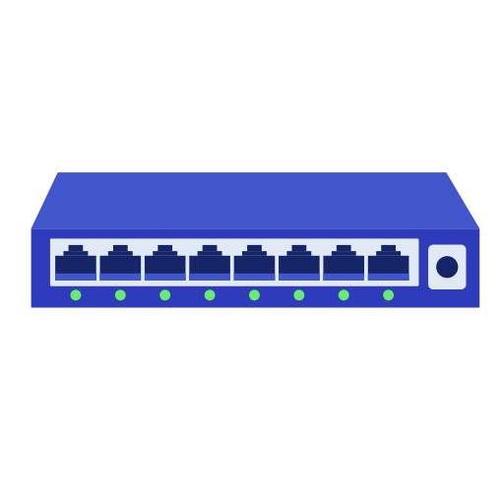
Sample Evaluation
Impact on Applications Due to Failure
Overhead of THORN
(see paper for more)
2.10GHz 64-core CPU,
Nvidia A100 GPU
100Gbps
(each port to diff ToR)
Mellanox 2710 ToR

Slide 22
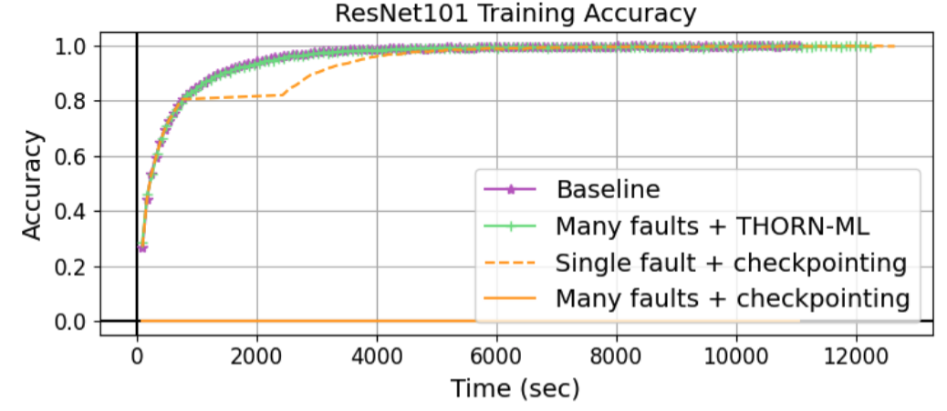
Evaluation: Minimal Impact to Application
Baseline: no THORN software, no faults
Faults: 20s down, 20s up (repeated).

Slide 23
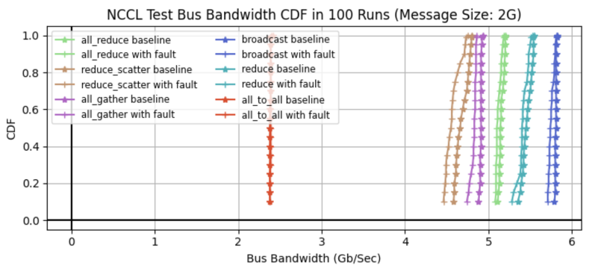
Evaluation: Minimal Overhead
Baseline is no THORN software, no faults occurring
With Fault is with THORN software inject fault that persists
NCCL library

Slide 24
Conclusions
Failure in distributed deep learning is quite costly
THORN
  Eliminates the costly downtime due to failures at the network edge
  While having minimal overhead and requiring no application changes
  See paper for more experiments and more system details

Slide 25


Thank You
eric.keller@colorado.edu
Maziyar Nazari, Dan Noland, Giulio Sidoretti, Erika Hunhoff, Tamara Lehman, Eric Keller
Acknowledgement – thanks for the support:

